Slide 1

Battle of the neighborhoods CAPSTONE Project Marc De Decker | Coursera Data Science Professional | January 23, 2019

Slide 2
Introduction
The audience for this project is an investor from Antwerp looking to open 3 new breakfast or coffee shops in the province of Antwerp, Belgium. The goal is to start small and expand in the future. That's why it's very important that they make the right choices for their initial investments. They want to start and open new shops in the province of Antwerp (Belgium) and depending on the success they want to open places in the rest of Flanders (Vlaanderen). The investor is not interested in doing business in Brussels or Wallonie which are the 2 other main parts of Belgium. The idea is to start the new coffee and/or breakfast shops in 3 dissimilar area's in respect to the number of similar existing shops but all being close to a shopping area, public transportation spots or other (touristic) attraction. It is important for the investor to understand if the success will depend on the number of shops that can be found in a radius of 1500m around the town center.

Slide 3
Data
Number of websites leveraged for data collection:
https://www.aggdata.com
https://api.foursquare.com/v2/venues/explore
Only data for the province of "Antwerpen”, Belgium
Town Centers with gps coordinates (latitude, longitude pairs)
Data downloaded as a csv file, containing:
Postal Code: postal code of the town
Place Name: the name of the town
State: indicates where the town is located in Belgium (possible values are Bruxelles-Capitale, Vlaanderen and Wallonie)
State Abbreviation: abbreviation of the state being BRU, VLG or WAL
City: indicates in which Province of Belgium the town is located
Latitude: latitude gps coordinate of the town
Longitude: longitude gps coordinate of the town

Slide 4
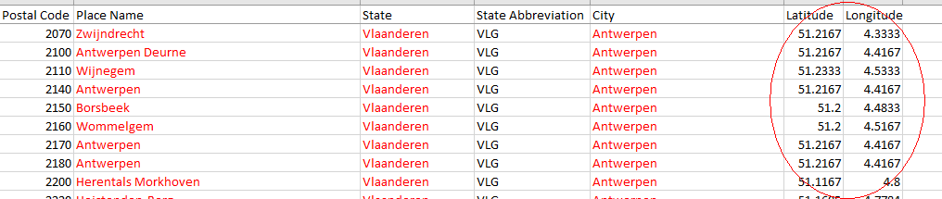
Data
The below shows part of the data of interest, all towns from "Antwerpen" (part of Vlaanderen) with the latitude, longitude gps coordinates of the town centers:
Note: Belgium has 3 main parts (Bruxelles-Capitale, Vlaanderen and Wallonie) but the whole of Belgium is divided into 9 provinces. For this project the investor is only interested in the province of "Antwerpen", part of Vlaanderen. Vlaanderen is the dutch-speaking part of Belgium while Wallonie is the french-speaking part of Belgium. Bruxelles-Capitale is the capital of Belgium, where both dutch and french are spoken.

Slide 5
Data
Selection criteria:
Select data where City = Antwerpen
Remove duplicate towns with identical gps coordinates (eg. town of Antwerpen is divided in different districts with different postal codes). This will leave us with 77 towns and the idea is to form 3 groups of towns. Each group will be different in regards to number of venues related to coffee/breakfast shops as well as shopping area’s, public transportation spots or other (touristic) attractions.
Additionally, a variety of Python packages will be used to analyze and display the data to gain insights and eventually provide a recommendation.

Slide 6
Methodology
Foursquare data in combination with above location data
To retrieve the number of similar places (venues) and the attractions in the direct neighborhood.
KMeans clustering
To divide the towns of "Antwerpen" in 3 clusters. The idea is to open one new shop in each of the 3 segments.
Data Exploration
Identify all the unique categories of venues returned by the Foursquare explore API.
Keeping only the venues of interest:
Coffee Shops and Breakfast Spots (target categories)
All categories involving shops, stores, public transportation and town attractions like theaters, zoo’s, etc.
Further exploration of the data exposed that 75% of the towns didn’t have more then 10 venues belonging to the categories we’re interested in. So it was decided to keep only the towns with at least 10 venues of these categories. This left us with 20 towns.

Slide 7
Results
The KMeans partition based clustering algorithm divided the towns in 3 segments, respectively containing 4, 3 and 13 towns. We will call these partitions Cluster 1, Cluster 2 and Cluster 3 onwards.
All the towns in Cluster 1 have a “coffee shop” as the top venue in a radius of 1500m around the town center (identified by the latitude and longitude coordinates). This uniquely classifies this cluster. The other main venues are all shops/stores and some attractions, but no public transportation stations.

Slide 8
Results
The towns in the second cluster (Cluster 2) also show some coffee shops (2 out of 3) but all rank 8th or less in the ranking of all relevant venues. So this cluster is clearly different from the first cluster and this is exactly what we are looking for.

Slide 9
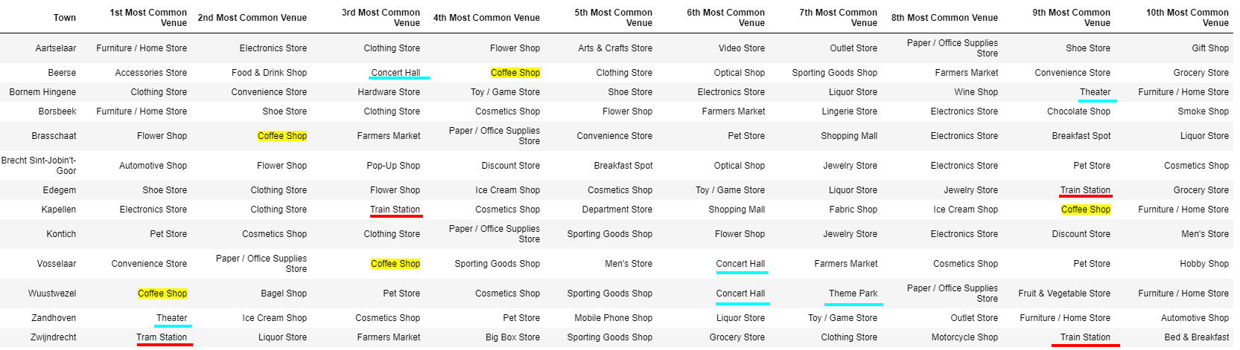
RESULTS
The Cluster 3 towns are then again different from the Cluster 1 and 2 towns as in only 25% of the towns a coffee shop is in the top 10 of venues. But all (except 1) are ranked with lower importance (spread between the 2nd and 9th position).
We can also note that only Cluster 3 has public transportation stations in their top 10 ranking of venues whereas all clusters show limited (touristic) attractions.

Slide 10
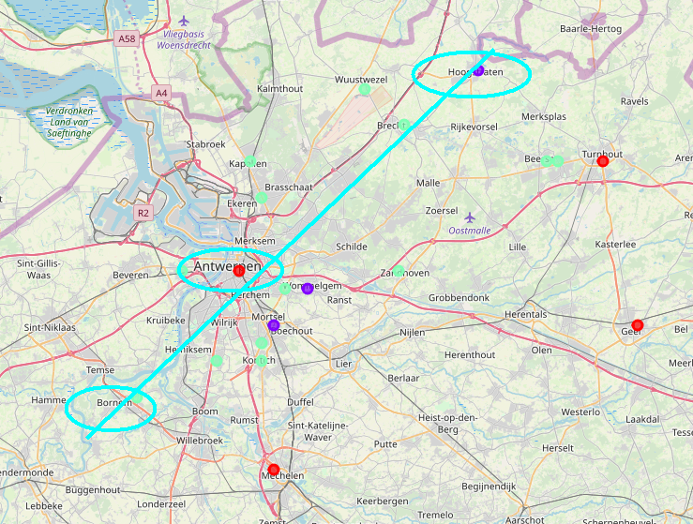
Discussion
It is obvious that our recommendation to the investor would be to open a new coffee/breakfast shop in one of the towns of each cluster identified.
Hoogstraten-Antwerpen-Bornem could be a good choice as these towns are geographically far away from each other. On the other hand it could be wise to choose for another town (like Mechelen or Geel) in Cluster 1 as Antwerpen probably has a higher risk in regards to competing with more similar shops.
Cluster 1: red circles
Cluster 2: purple circles
Cluster 3: green circles

Slide 11
Discussion
Hoogstraten would be the most recommended spot in Cluster 2 as it is more isolated from the rest of the towns included in this analysis.
The decision where to start a shop in Cluster 3 can’t be positively identified based on this analysis and would require further market analysis. Maybe it should be recommended to start a new shop in the town which is geographically the furthest away from the towns chosen for Cluster 1 and 2.

Slide 12
CoNCLUSION
The KMeans classification technique gives the investor a good idea how and where to spread his new shops, based on the type of venues identified by the Foursquare api. However this type of analysis does not uniquely identify the best town to start a new shop but it gives a pretty good idea of how the province of Antwerp can be segmented based on the criteria put forward by the investor. This will prevent the investor of opening 2 shops in the same type of neighborhood, having the same type of venues nearby.

